Slide 1
Team: Kickers Work In Progress
Prashid Pradhan
Jhalak Budhathoki
Adarsh Rauniyar
Sagar Kalfe

Slide 2
Belbin Analysis
Members | Primary Role | Secondary Role | Least Likely Role | Role To Improve
Prashid Pradhan | Plant, Co-ordinator | Team Worker, Monitor Evaluator | Resource Investigator | Resource Investigator
Adarsh Rauniyar | Specialist | Shaper | Team worker | Complete finisher
Jhalak Budhathoki | Team Worker | Monitor Evaluator | Co-ordinator | Shaper
Sagar Kafle | Plant, Shaper, Implementer | Complete Finisher | Monitor Evaluator | Team Worker

Slide 3
PROJECT PURPOSE
To provide the traders and customers of Cleckhuddersfax completely new taste of shopping. the Traders of Cleckhuddersfax will have a unique e-commerce web-portal where the traders can show case their product online for selling purpose and the customers can buy from the traders online.

Slide 4
OBJECTIVE
Developing a complete package of e-commerce web-portals integrated with an online payment.
Accomplishment of Web-Portal by 2016- -

Slide 5
Project Scope
Customer can navigate through the product by shop and product type.
Search facility.
Online Payment
Cart facility

Slide 6
Moscow approach (Requirements)
Customer Interface
Registration/Log In details
Cart facility
Online payment
Edit account details
Trader Interface
Add/Update/Remove Products
Update/Remove Shops
Super Admin Interface
View/ Add/ Update/ Delete Customers, Traders, Products

Slide 7
Requirements (Non- Functional)
Separate user sessions
Password protection
Convincing User Interface

Slide 8
Skill Audit
Skill | Training For | Level | Training Objective | Training Medium | Time(hrs) | Completion Date
HTML | Adarsh, Jhalak | 4
PHP | Prashid, Sagar, Adarsh | 4 | Server-side Validation, Mailing Features | Youtube, Tutorials, w3schools.com | 10 | 2016/03/26
CSS | Adarsh, Jhalak | 4
JAVASCRIPT | Adarsh, Jhalak | 2
PAYMENT GATEWAY INTEGRATION | Sagar | 5 | Addition of E-sewa and Pay pal | Youtube, Tuturial | 5 | 2016/03/27
APEX ORACLE | Sagar, Prashid, Jhalak | 4 | Connection and implementation of trigers | Youtube, Tuturial, docs.oracle.com | 5 | 2016/03/22
TESTING AND EVALUATING | Sagar, Adarsh, Jhalak, Prashid | 5
DOCUMENTATION | Sagar, Adarsh, Jhalak, Prashid | 4

Slide 9
Gantt Chart

Slide 10
Communication Tool (Github)

Slide 11
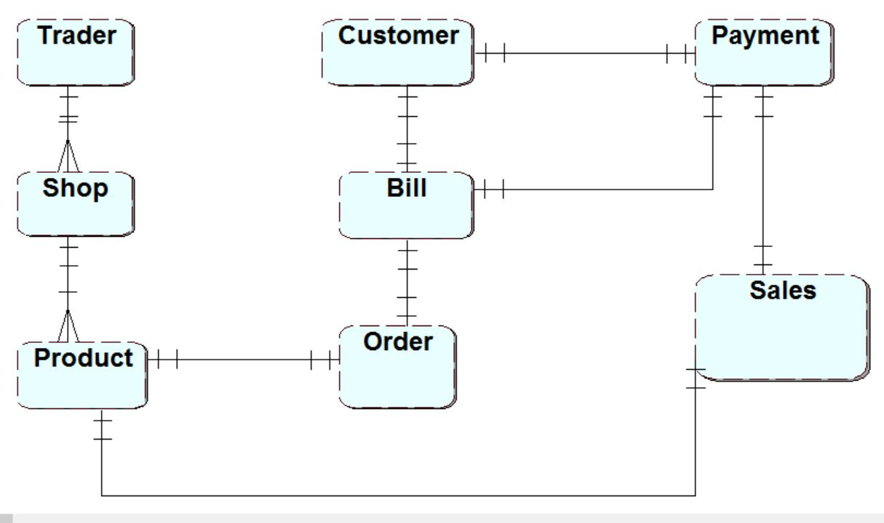
Entity Relationship Diagram

Slide 12
Use Case Diagram

Slide 13
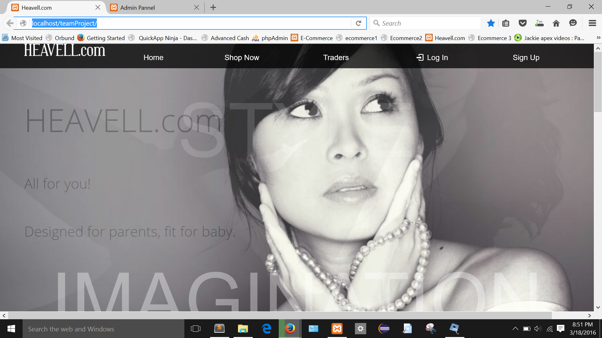
Screenshots. Homepage

Slide 14
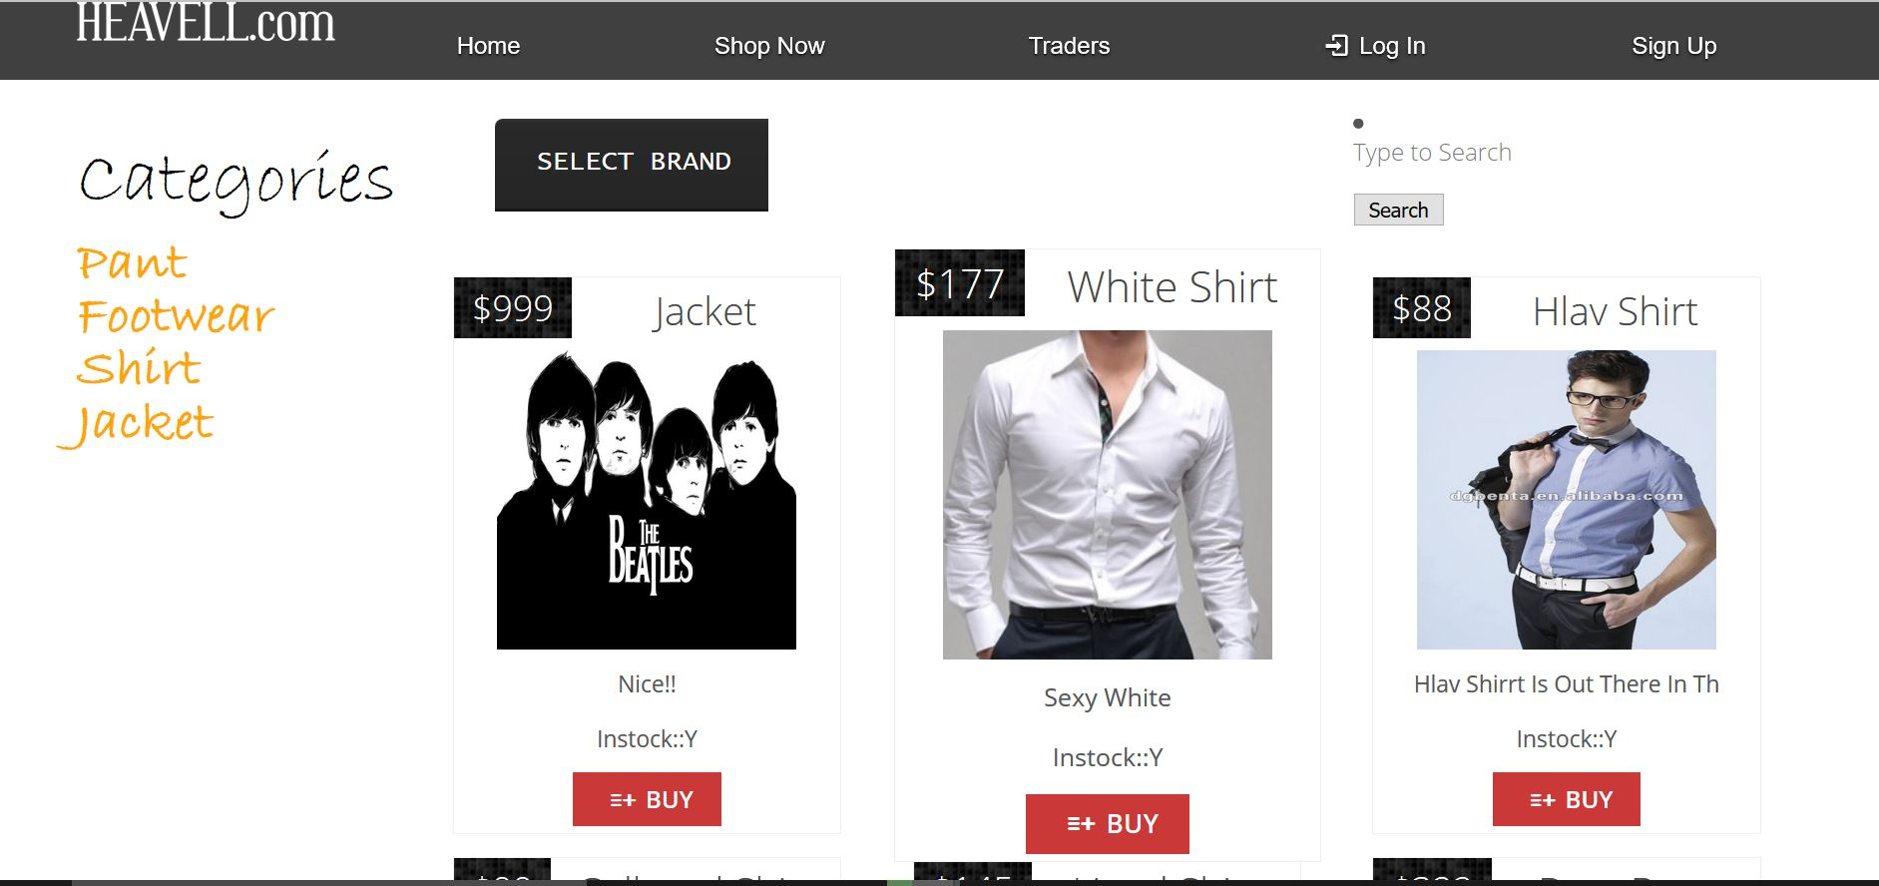
Browsing Interface

Slide 15
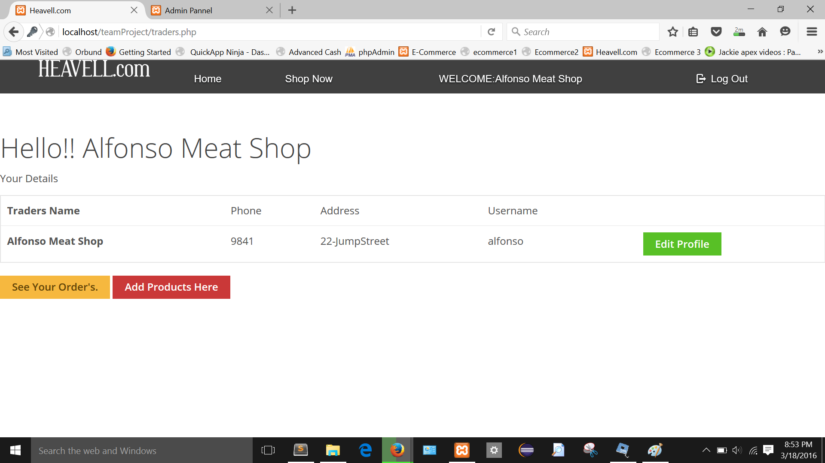
Traders Interface

Slide 16
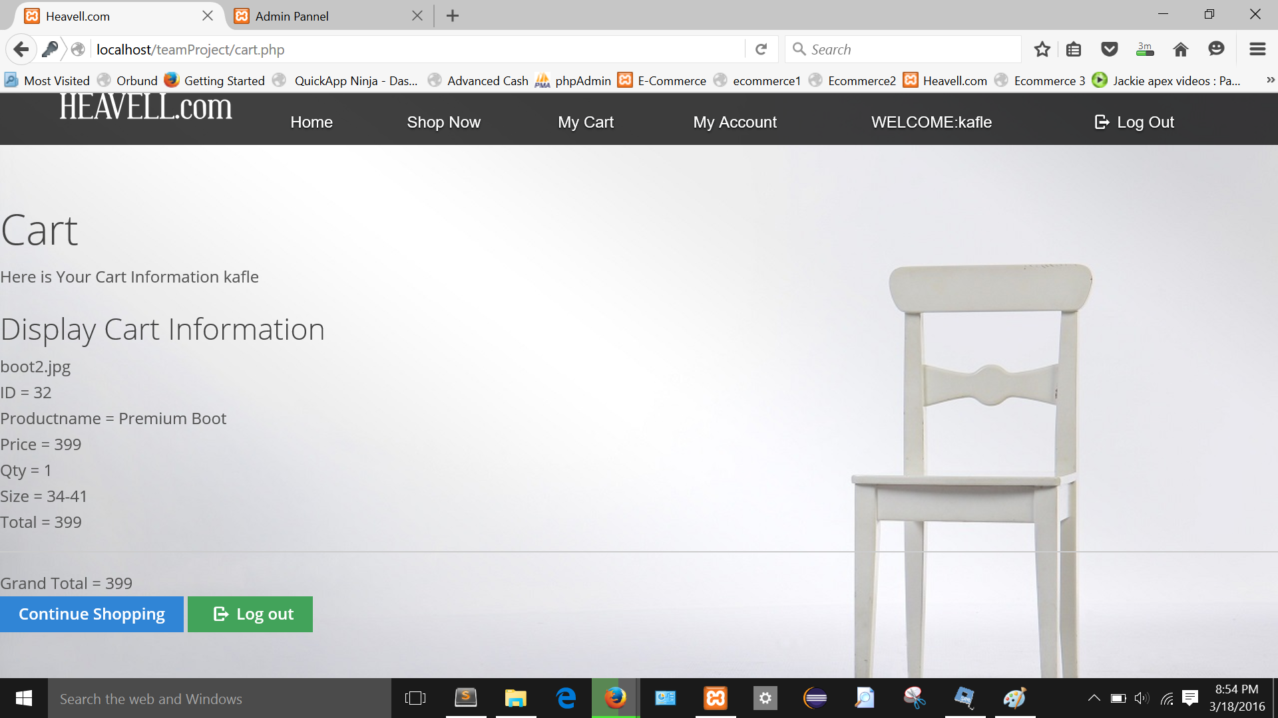
Customer interface

Slide 17
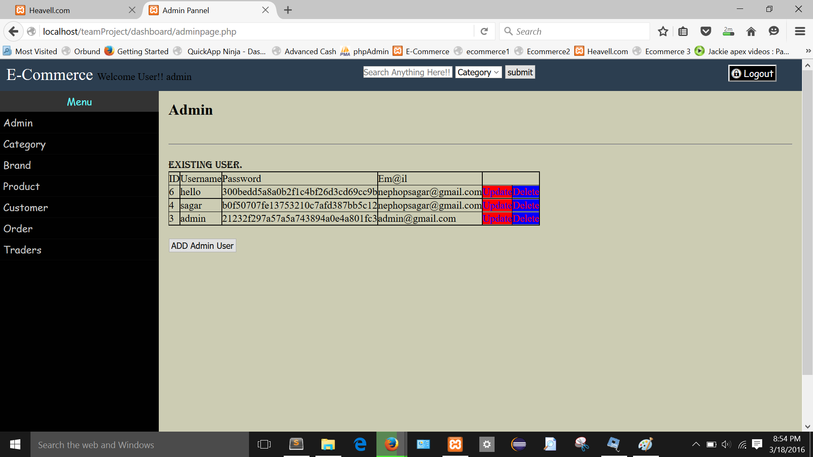
Super Admin

Slide 18
Thank You!!

